Slide 1
Digital to Physical: Machine Learning for Control System Simulations
Evan Moore
9/25/26

Slide 2
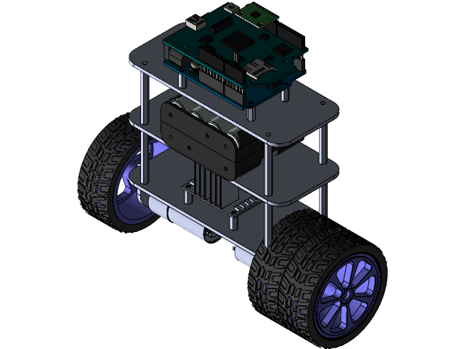
Slide 2: Project Goals
Apply machine learning (ML) to simulations of real-world control systems
Explore the gap between theory (physics & simulations) and practicality (physical systems)
Bridge that simulation gap with ML compensation
Overall Goal:
Streamline the process of critically balancing control systems
Notes:
In the first project work day (Week 3) you will provide background and context for your project. In subsequent weeks you only need to provide that quick reminder of the Major goals (on sentence to remind the team of your Project.)
As you progress your goals, or scope may have changed. Please share your thoughts.

Slide 3
Slide 3: Progress
Organized a software stack
Lagrangian Physics Simulation Created
Motor interference, sensor noise, max torque, etc
Models plugged in
Performance optimizations for local hardware
Unified parameter configuration file
Notes:
The first project workday is only a week after the contract submission and may not have much progress which is fine.
In later session you can work from you list of goals from prior workday and describe progress.

Slide 4
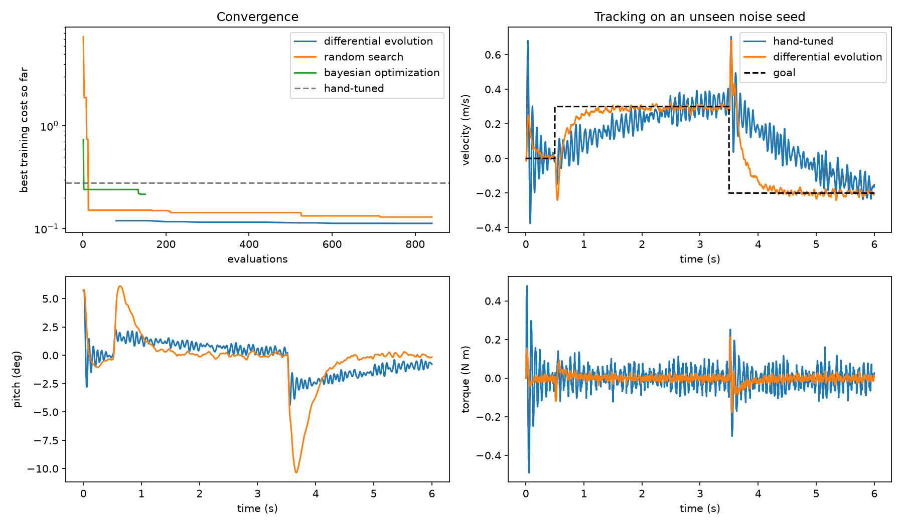
Slide 3: Progress
Started to explore current literature
“Physics Informed Machine Learning”
“White Box” vs “Black Box” modeling
Notes:
The first project workday is only a week after the contract submission and may not have much progress which is fine.
In later session you can work from you list of goals from prior workday and describe progress.

Slide 5
Slide 4: Challenges/Issues
Simulation times are long
Visualization is difficult
Moderate tech debt
Notes:
Identify any problems or issues you are facing. This could be intellectual sticking points, difficulty finding information, getting materials, etc. The team may have ideas to help you with these issues, or they are items that have change your short term priorities.

Slide 6
Slide 5: Goals
Establish an understanding of current ML physics simulation literature
Build a classical physics simulation in Python
Connect ML models
Use established control system benchmarking methodologies to compare model convergence
Build physical model and compare to the simulation?
Notes:
We will talk about project management in ENGR 130. For the first session you can list out all the major action you need to accomplish to achieve your goals. Think of these as the list of action items we discussed for team meetings.

Slide 7
Presentation to be turn in each project workday:
Powerpoint Presentation to Gradescope.
Week | Date | Topics/Class time | Due
1 | 8/29 | Course Intro/Problem finding | M1: Draft of potential ideas for Project
2 | 9/5 | Peer Mentoring Day 1 | Project Proposals – Form 23 due
3 | 9/12 | Project Workday | Progress Update 1
4 | 9/19 | Peer Mentoring Day 2
5 | 9/26 | Project Workday | Progress Update 2
6 | 10/3 | Peer Mentoring Day 3
7 | 10/10 | In-class Design Review | M2: Midterm Design Review
8 | 10/17 | Peer Mentoring Day 4 | --
9 | 10/24 | Project Workday | Progress Update 3 + Draft of Final Report
10 | 10/31 | Peer Mentoring Day 5
11 | 11/7 | Project Workday | Progress Update 4
12 | 11/14 | Project Workday | Project Update 5
 | 11/18 | Fall Undergraduate Research Expo | Possible opportunity to showcase work
13 | 11/21 | Peer Mentoring Day 6 | Draft of Final Report
14 | 11/28 | Thanksgiving | No Class
15 | 12/5 | In-class demo/presentation | M3: Final Presentation
16 | 12/12 | Adjournment | M3: Final Presentations if needed

